Slide 1
NAME : SHAFRIN SHA R S REG NO : 813821104089 DEPARTMENT:COMPUTER SCIENCE AND ENGINEERING
Final Project
3/21/2024 Annual Review

Slide 2
PROJECT TITLE
Predictive Modeling for Gender and Age
Identification using Keras and TensorFlow.
3/21/2024 Annual Review

Slide 3


AGENDA
vPROBLEM STATEMENT
vPROJECT OVERVIEW
vWHO ARE THE END USERS?
vYOUR SOLUTION AND ITS VALUE PROPOSITION
vTHE WOW IN YOUR SOLUTION
vMODELLING
vRESULTS
3/21/2024 Annual Review

Slide 4

PROBLEM STATEMENT
Develop a machine learning model using Keras and TensorFlow to predict gender and age based on diverse input data, including facial images and textual information.
The model aims for accurate identification across various demographics and backgrounds.
3/21/2024 Annual Review

Slide 5

PROJECT OVERVIEW
The goal of this project is to create a software application using Keras with TensorFlow that can predict the gender and approximate age of individuals based on their photographs.
This model incorporates diverse features such as facial images, textual data, or any relevant information contributing to accurate predictions.
The objective is to develop an efficient and robust model capable of precisely identifying an individual's gender and age group, accommodating different backgrounds and demographics.
3/21/2024 Annual Review

Slide 6

WHO ARE THE END USERS?
Academic researchers
marketing experts
social media platforms
entertainment industry stakeholders
3/21/2024 Annual Review

Slide 7
YOUR SOLUTION AND ITS VALUE PROPOSITION
Solution:
Utilizing deep learning for age and gender prediction entails crafting a neural network model trained on a dataset annotated with age and gender labels. The model's architecture may consist of a convolutional neural network (CNN), or a hybrid incorporating both CNN and recurrent neural network (RNN) layers, tailored to the task's intricacy.
Value Proposition:
Accurate Predictions
Diverse Data Handling
Robustness and Efficiency
Applications in Multiple Fields – Retail,Healthcare,Entertainment
Exploration of Deep Learning Techniques
3/21/2024 Annual Review

Slide 8
THE WOW IN YOUR SOLUTION
Multi modal approach:Utilizing a multi-modal approach, the model integrates various features like facial images and textual data to augment prediction accuracy.
Advanced Deep Learning Techniques:Employing advanced deep learning techniques, the project delves into architectures such as convolutional neural networks (CNNs) for image processing and recurrent neural networks (RNNs) for textual analysis.
Real World Applications:With significant real-world implications, the precise prediction of gender and age finds application in demographics analysis, targeted advertising, personalized services, and more.
Robustness and Efficiency:Designed for robustness and efficiency, the model can adeptly handle diverse input data, delivering accurate predictions in real-time or near-real-time scenarios.
Potential for Innovation:This endeavor expands the horizons of deep learning in gender and age prediction, fostering potential for future research and innovation in refining predictive models and exploring novel applications in demographics analysis and beyond.
3/21/2024 Annual Review
8

Slide 9
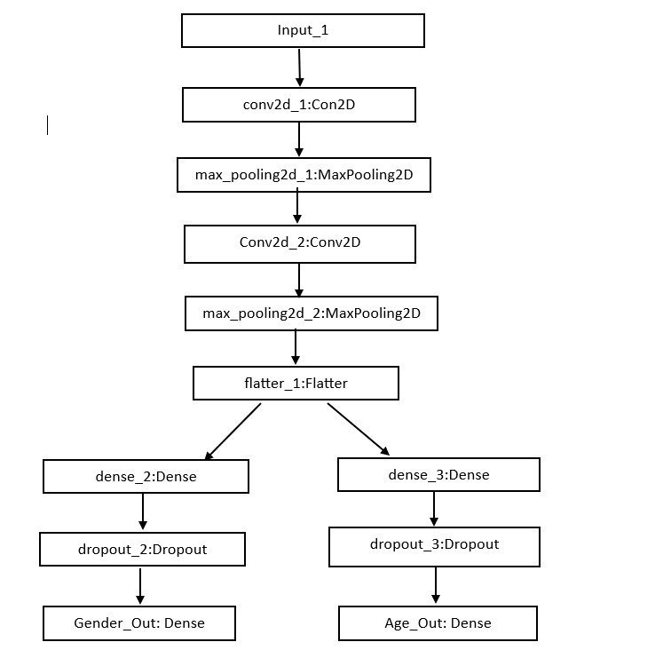
MODELLING
3/21/2024 Annual Review
9

Slide 10
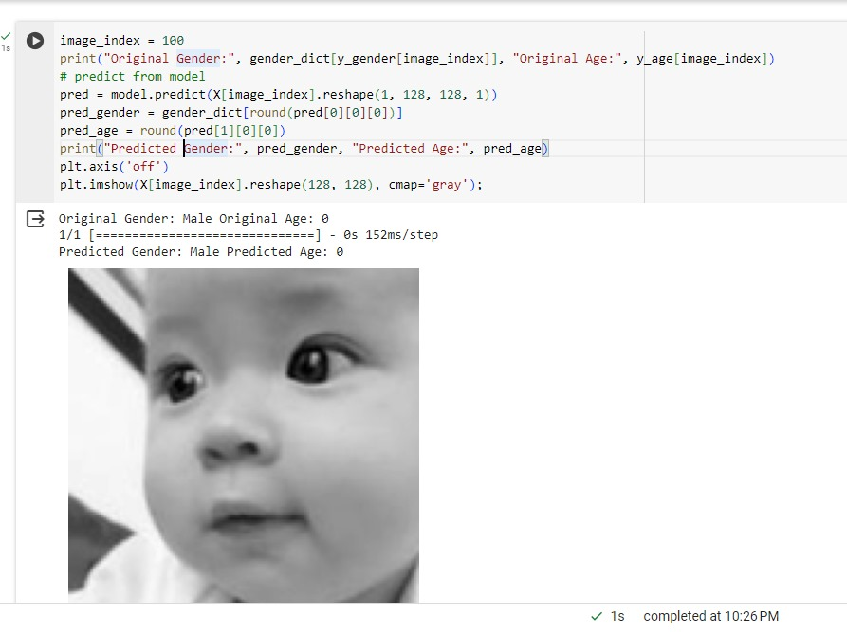
RESULTS
Incorporating Convolutional Neural Networks (CNNs), this project examines image patterns and features to predict the gender and approximate age of individuals depicted in photos. Although the model's predictions may not be perfectly precise, they provide valuable insights applicable to targeted advertising, demographic analysis, and entertainment purposes.
Github link : https://github.com/shafrinsha/TNSDC-Generative-AI
3/21/2024 Annual Review
10

